Slide 1
Speciation and Population Structure of Aegialites Beetles
Casey Bickford
MS Student
University of Alaska Fairbanks

Slide 2
Overview
Description of Aegialites
Taxonomy and classification
Undescribed Aegialites population of Kasatochi Island
Population structure of Aegialites debilis in Sitka
Similar studies of population structure
Literature Cited

Slide 3
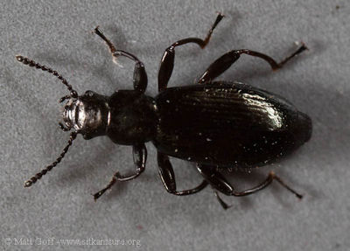
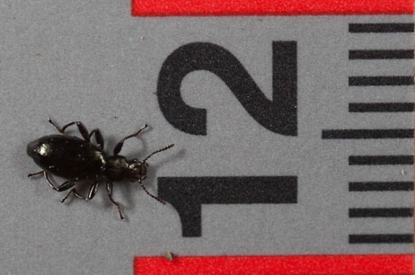
An Introduction to Aegialites
Coleoptera: Salpingidae: Aegialitinae
Wingless
3-5mm in length
Found in intertidal rock crevices of the North Pacific
Upper splash zone
Widely separated coxae and long tarsi
Range from northern California through Alaska and into the Kuriles and Japan
Photos by Matt Goff

Slide 4
Prime Aegialites habitat
Photo by Steve Peek

Slide 5
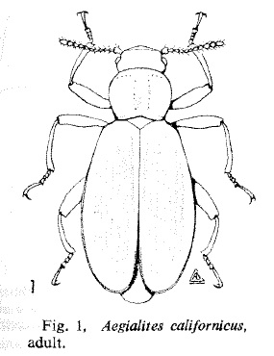
Taxonomy
First described by Mannerheim 1853 with A. debilis
Spilman (1964) revised the subfamily Aegialitinae, including Aegialites with Antarcticodomus and Elosoma
Zerche (2004) revised the genus, increasing the number of species from 4 to 30 based on male genitalia morphology
Spilman (1964)
No species is known from more than one location
Zerche concluded that all Aegialites species are local endemics

Slide 7
Possibly a product of under-sampling
Populations have been found on every island recently surveyed (>28) in the Aleutian Archipelago

Slide 8
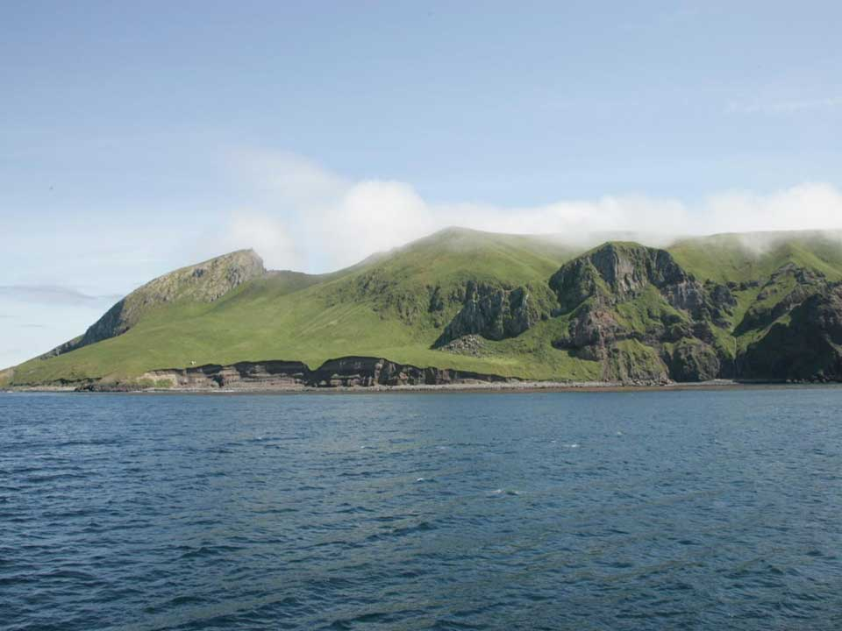
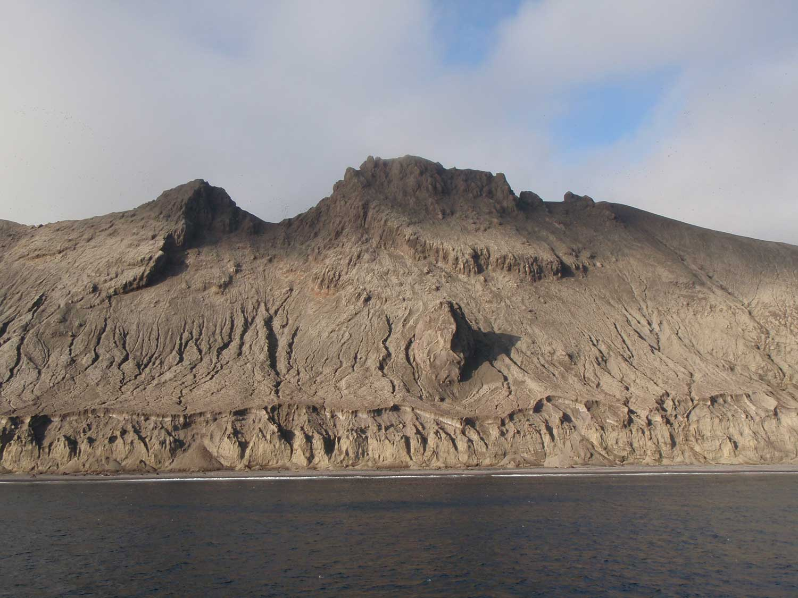
Part 1: The Undescribed Species of Kasatochi Island
Small stratovolcano
Dr. Derek Sikes sampled for terrestrial arthropods in June 2008 as part of a USFWS inventory of the Aleutian Islands
Six specimens of Aegialites were found and determined to be undescribed by V. Gusarov
Kasatochi erupted in August 2008, burying the island in ash and pyroclastic flow (Sikes and Slowik 2010)
Photo by Vernon Byrd, USFWS
Photo by George Esslinger, USGS

Slide 9
Alas Poor Species, We Hardly Knew Ye
Dr. Sikes has returned every following year to collect arthropods and document the ecosystem’s recovery
All suitable Aegialites habitat seems to be destroyed
No Aegialites have been collected since
Has this new species gone extinct?
Photo by Gary Drew, USGS

Slide 10
Methods
Use UAM’s Aegialites collection
Extract DNA from pre-eruption Kasatochi Aegialites specimens as well as from populations on 10 nearby islands
Koniuji, Ulak, Great Sitkin, Aziak, Asuksak, Tanaklak, Kanu, Umak, Igitkin, and Atka
Sequence and compare the mitochondrial DNA genes COI and COII of each specimen
Dissect the male genitalia for morphological comparison

Slide 12
Possible Outcomes
Kasatochi species found on other islands
Not extinct
Not all species are local endemics
Not found on other islands
Dispersal ability is very low
Likely extinct
Zerche’s hypothesis holds

Slide 13
Part 2: Aegialites at a Finer Scale Sitka Population Structure
Tiana Bactad (overseen by Dr. Sikes and K. LaBounty of UA Southeast)
Assissting on a genetic comparison of Aegialites debilis populations
Determine the amount of genetic variation between populations
Indirect measure of gene flow and dispersal ability
Amplify and sequence COI and COII

Slide 14
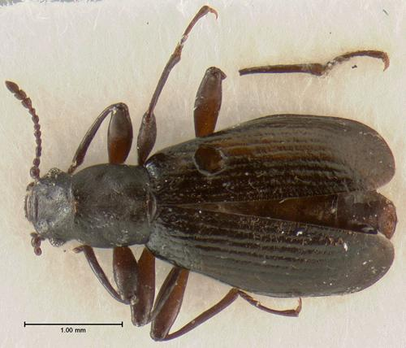
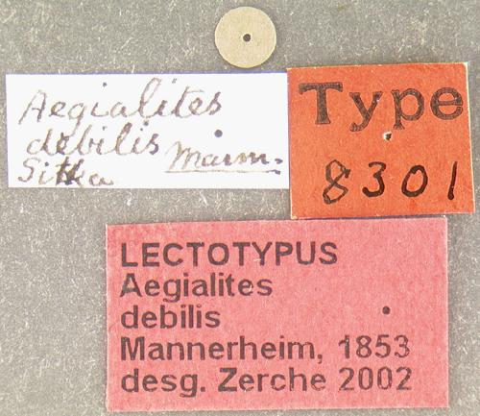
Sitka is the type locality of Aegialites debilis Mannerheim 1853
A. debilis is also the type species of the genus
Photos by Harvard University’s MCZ Type Database

Slide 15
A Similar Approach: Hojito et al 2010
Aegialites stejnegeri on Hokkaido, northern Japan
Two distinct lineages found

Slide 18
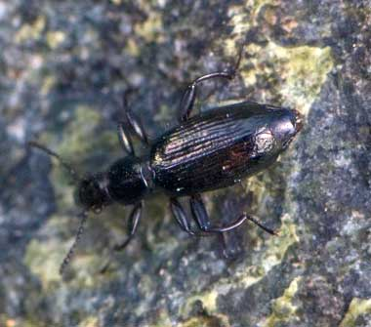
Hojito et al 2010 did not update the taxonomic status of A. stejnegeri, despite the genetic evidence
Sitka study will take the next step if large divisions in the population structure are found

Slide 19
Literature Cited
Hojito, S., N. Kobayashi, H. Katakura. 2010. Population Structure of Aegialites Beetles (Coleoptera, Salpingidae) on the Coasts of Hokkaido, Northern Japan. Zoological Science, 27(9):723-728
Sikes, D. S. and J. Slowik. 2010. Terrestrial arthropods of pre- and posteruption Kasatochi Island, Alaska, 2008-2009: A shift from a plant-based to a necromass-based food web. Arctic, Antarctic and Alpine Research. 42: 297-305.
Spilman, T.J. (1967) The heteromerous intertidal beetles. Pac. Insects 9, 1–21.
Zerche, L. 2004. Revision der Gattung Aegialites Mannerheim (Coleoptera: Salpingidae: Aegialitinae). Stuttgarter Beitrage zur Naturkunde, Serie A (Biologie), no. 666. 1-99.

