Slide 1
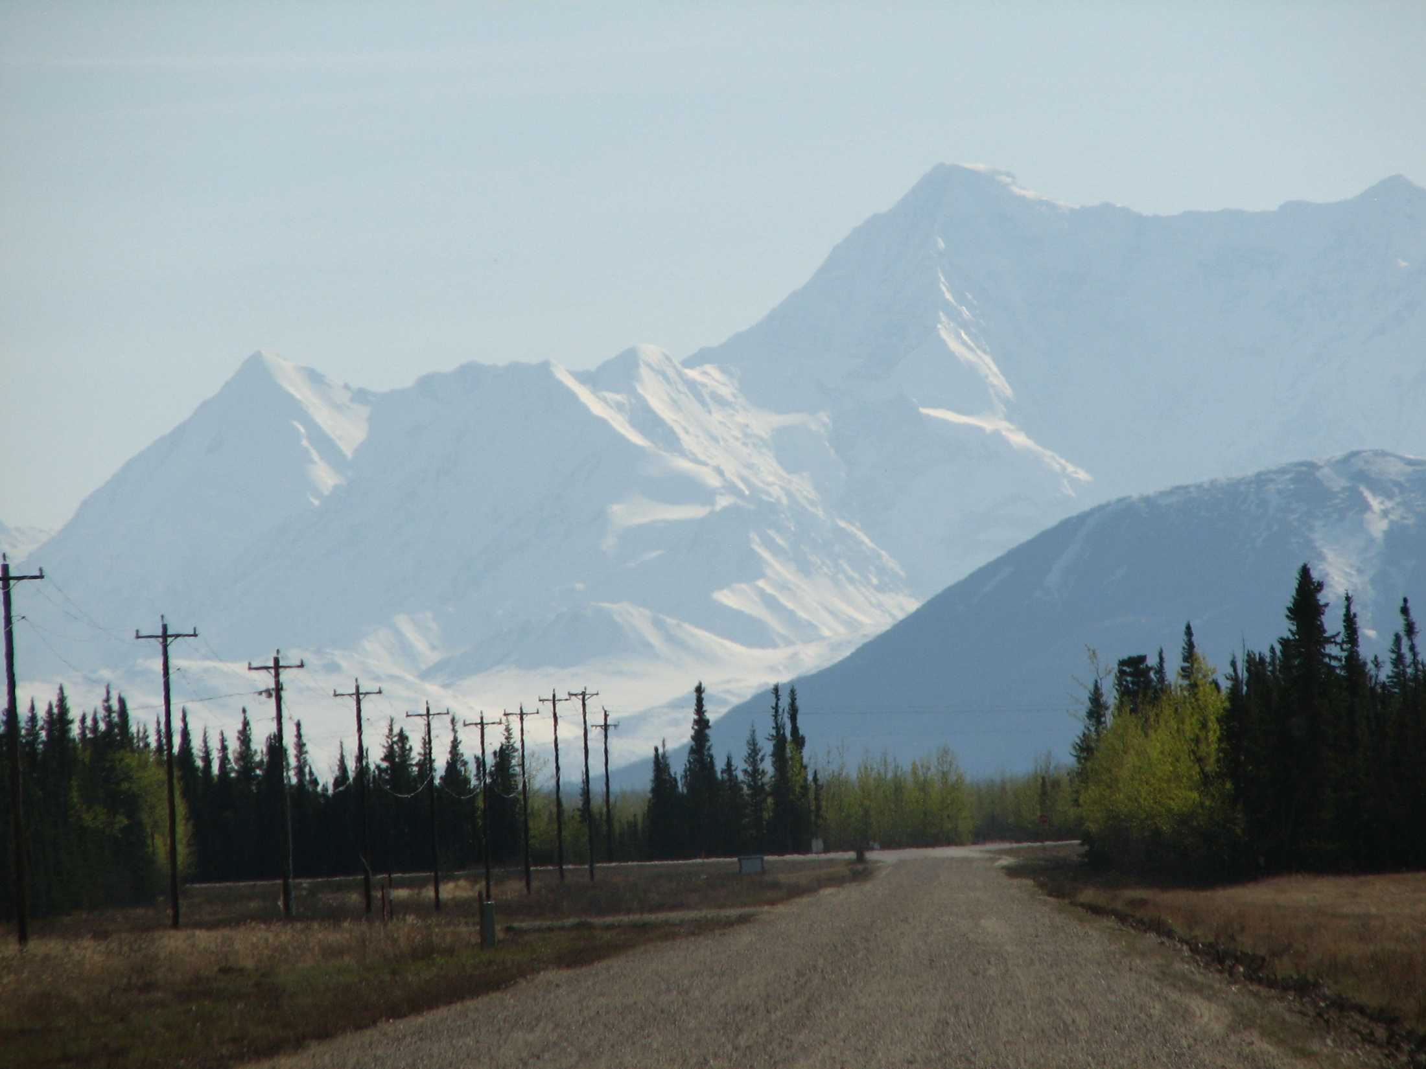
Influence of Field Age on the Ground Spider Community in CRP Grasslands, Delta Junction, Alaska.
Brandi Fleshman, USDA-ARS, UAF
Dr. Alberto Pantoja, USDA-ARS
Dr. Derek Sikes, UAM
Dr. Michael Draney, UWGB
Spruce Rd., Delta, AK

Slide 2
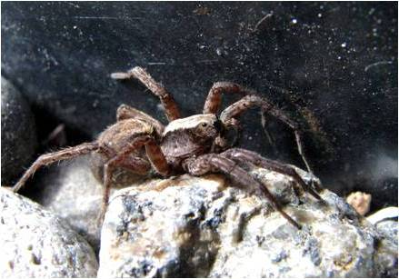
Introduction
The occurrence of predators can influence, and be influenced by, features of the plant community (Siemann et al. 1998, Rypstra et al. 1999)
Spiders the most abundant and diverse arthropod predators in grasslands (Rushton & Eyre 1992)
Alopecosa aculeata (Clerck)
Notes:
Predators play an important role in ecosystems, because they regulate herbivores, which influence plant abundance, diversity and productivity.
However the vegetative community can also impact predator occurrence: directly by providing shelter, creating a variety of microclimates, and influencing foraging efficiency, and also indirectly by supporting a diversity of prey populations and affecting nutritional quality of prey (Rypstra et al. 1999; Uetz 1991)

Slide 3
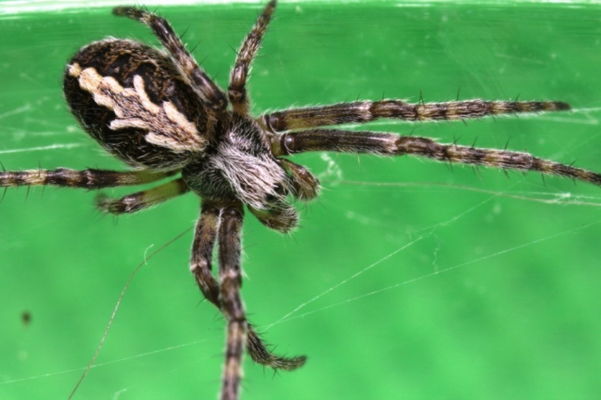
Introduction
Immature Dictynid
The importance of vegetation structure and diversity has been demonstrated for web-building spiders (Uetz 1991)
The relationship between vegetation, succession and ground spider communities is less clear (e.g. Hurd & Fagan 1992; Mallis & Hurd 2005, Bultman et al. 1982)
Not clearly understood if spider communities change in predictable ways with successional age of habitats, or which specific habitat characteristics influence those changes (Bultman et al. and refs therein)
Notes:
It has been demonstrated that web spider diversity increases with increasing plant heterogeneity, such as is usually seen across successional gradients. Vegetation structure and complexity is important for supporting a diversity community of web building spider species, by providing a variety of web-building locations and microhabitats. (Greenstone 1984, Rypstra et al. 1999, Mrzljak & Wiegleb 2000, others…)
A similar relationship between vegetation heterogeneity and/or successional age of habitat, with species diversity has been suggested for ground-active spiders, however, the relationship is less clear. Bultman et al. 1982, and M found evidence to support general theory of increasing diversity with successional age. One study found ground-active spider diversity to be lower in old fields than young fields (Hurd and Fagan 1992), but was higher in more woody habitats as opposed to herbacious, and another (Mallis & Hurd 2005) found no relationship between spider diversity and vegetation structure or successional age.
It is also not clearly understood if spider communities undergo succession. Some authors show that habitats along a successional gradient or with differing levels of vegetation complexity (Bultman et al. and refs therein) are characteristically different. Other authors, however, such as Mallis and Hurd 1992, suggested that spider assemblages do not undergo succession, and their composition is based largely on stochastic colonization events and specific habitat requirements.

Slide 4
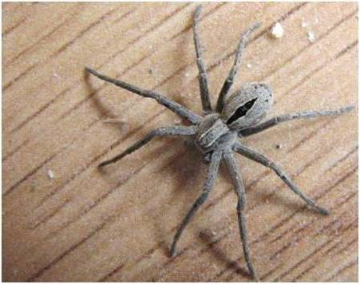
Introduction
Thanatus formicinus (Clerck)
Conservation Reserve Program
Cropland -> managed grasslands
CRP Goals – wildlife habitat, natural resources
18,449.8 acres in Alaska (spring 2010)
18,024.8 acres in Delta Junction
In Delta, CRP grasslands are usually managed by mowing every 2-3 years in the fall
Seefeldt et al. 2010 – Over time in CRP, the number of plant species increased at a rate of >2 per Yr.
Notes:
CRP is a federal program that provides incentive for farmers to take highly erode-able croplands out of production, plant them with a vegetative cover, and maintain them as managed grasslands that are available for future use.
In addition to its original purpose of reserving croplands in a ready state for future agricultural production, the current goals of the CRP include providing wildlife habitat and protecting natural resources.
Compliance with the CRP objectives requires maintenance for ease of conversion back to cropland -> In Delta, the CRP enrolled fields are managed primarily by mowing every 2-3 yrs in the fall after the bird breeding season is over
Seefeldt et al. surveyed vegetation in CRP fields in Delta and found that between young and old CRP fields, there was an increase in native grass, forb, shrub and tree species, and a decrease in the planted introduced grasses. Despite the management of these fields by regular mowing, they found that time in the CRP (i.e. years since planting) was the only factor consistently influencing plant succession

Slide 5
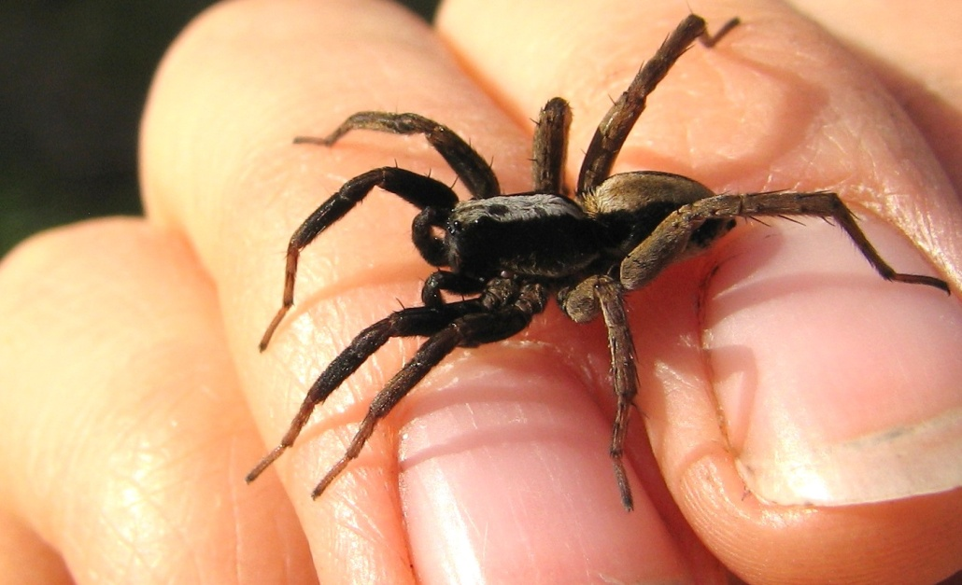
Introduction
Few studies have investigated arthropods in CRP lands
None have looked specifically looked at spider diversity in CRP lands
In this study, we collected ground-active spiders in CRP fields by pitfall trap for two summers (2006-2007)
Alopecosa aculeata (Clerck)
Notes:
Those that have, examined overall abundance of certain groups, because of their importance as a food source for young birds. Spiders are one such group that is considered to be an important food source for young birds.
Appears to be very few studies that have examined species level diversity of any arthropod group, and none have specifically looked at spider diversity in CRP lands

Slide 6
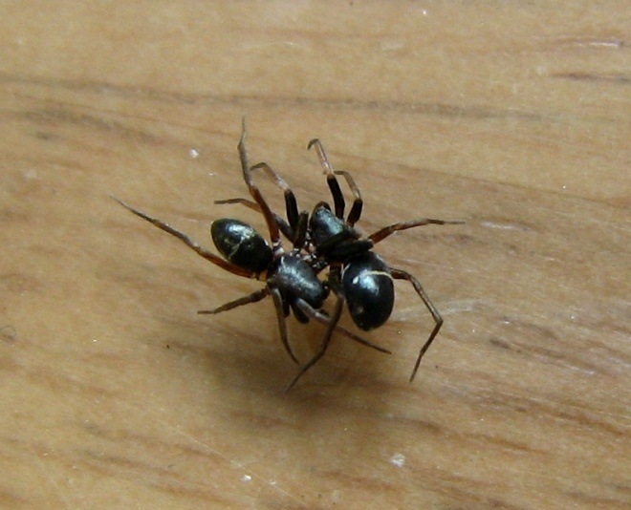
Research Goals
Primary Goal:
Investigate the diversity and species composition of ground-active spiders in young (8-10 yrs) and old (19-yrs) CRP grasslands
1) Is ground spider diversity higher in old fields than young fields?
2) Does the species composition of ground spiders differ between young and old fields?
3) Can the differences in species composition of ground spiders between old and young fields be explained by differences in vegetation characteristics?
Secondary Goal: Contribute to the
documentation of the spider fauna of Alaska
Micaria pulicaria (Sundevall)
Notes:
Primary Goal: Address the following questions
Secondary Goal: Carryout significant collection effort in a relatively un-studied area in contribution to the documentation of Alaskan spiders.

Slide 7
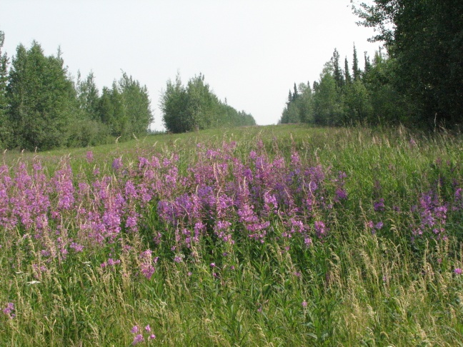
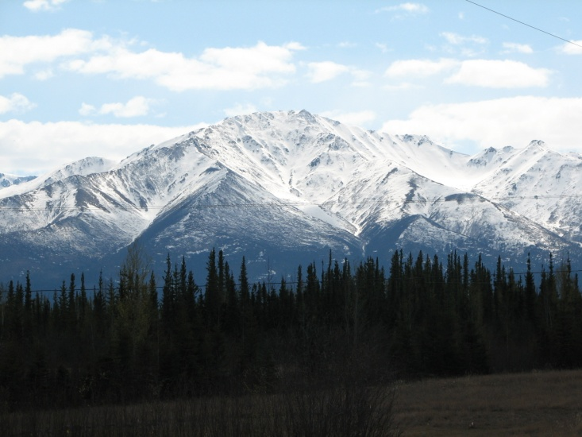
Study Area
CRP field, Delta, AK
Outside city of Delta Junction
8 collection plots were randomly selected from the 40 plots sampled by Seefeldt et al. (2010).
4 Young plots (8, 9, 9 and 10 yrs in CRP), and 4 Old plots (all 19 yrs in CRP)
At time of CRP enrollment, fields were planted with mixed, non-native grasses: brome grass, red fescue, timothy, clover and/or bluegrass.
Surrounding habitat is boreal forest
Vegetation data from CRP fields was collected
in 2005 and 2008 by Seefeldt et al.
UAF Farm, Delta, AK
Notes:
Delta – Approx 160 km south of Fairbanks
Old and young sites are relatively interspersed, not clumped together
Succession is taking place in varying degrees at different sites.
Boreal forest – dominated by white and black spruce, mixed with quaking aspen, paper birch and balsam poplar and tamarack.
Vegetation data was sampled by Seefeldt et al. in 2005 and 2008 – and included estimates of plant species richness and % cover of forbs, grass, shrubs and litter.

Slide 8
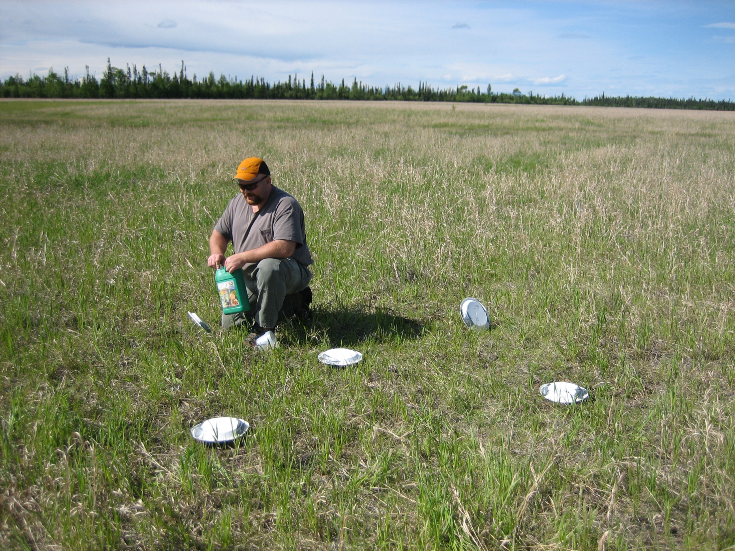
Young CRP Field
Notes:
Dead grass layer cover the ground from previous years

Slide 9
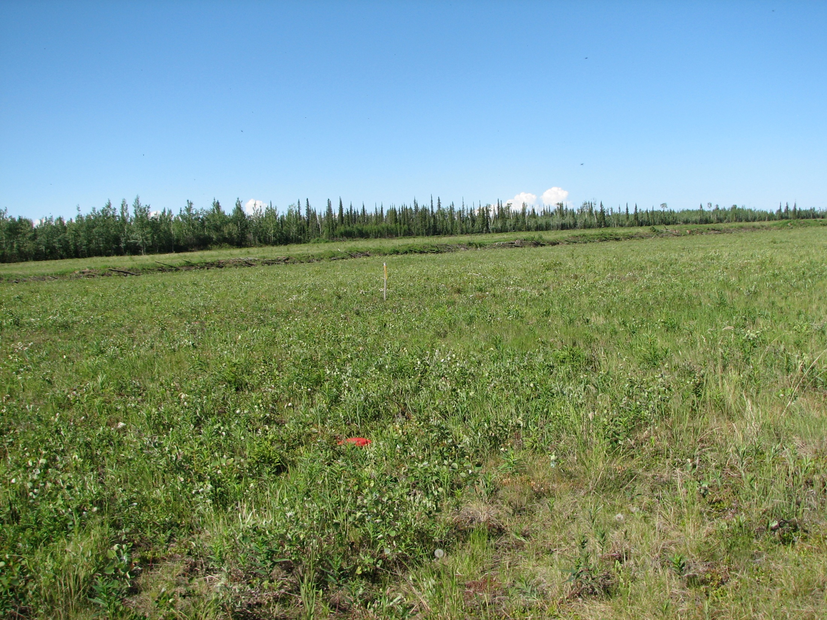
Old CRP Field

Slide 10
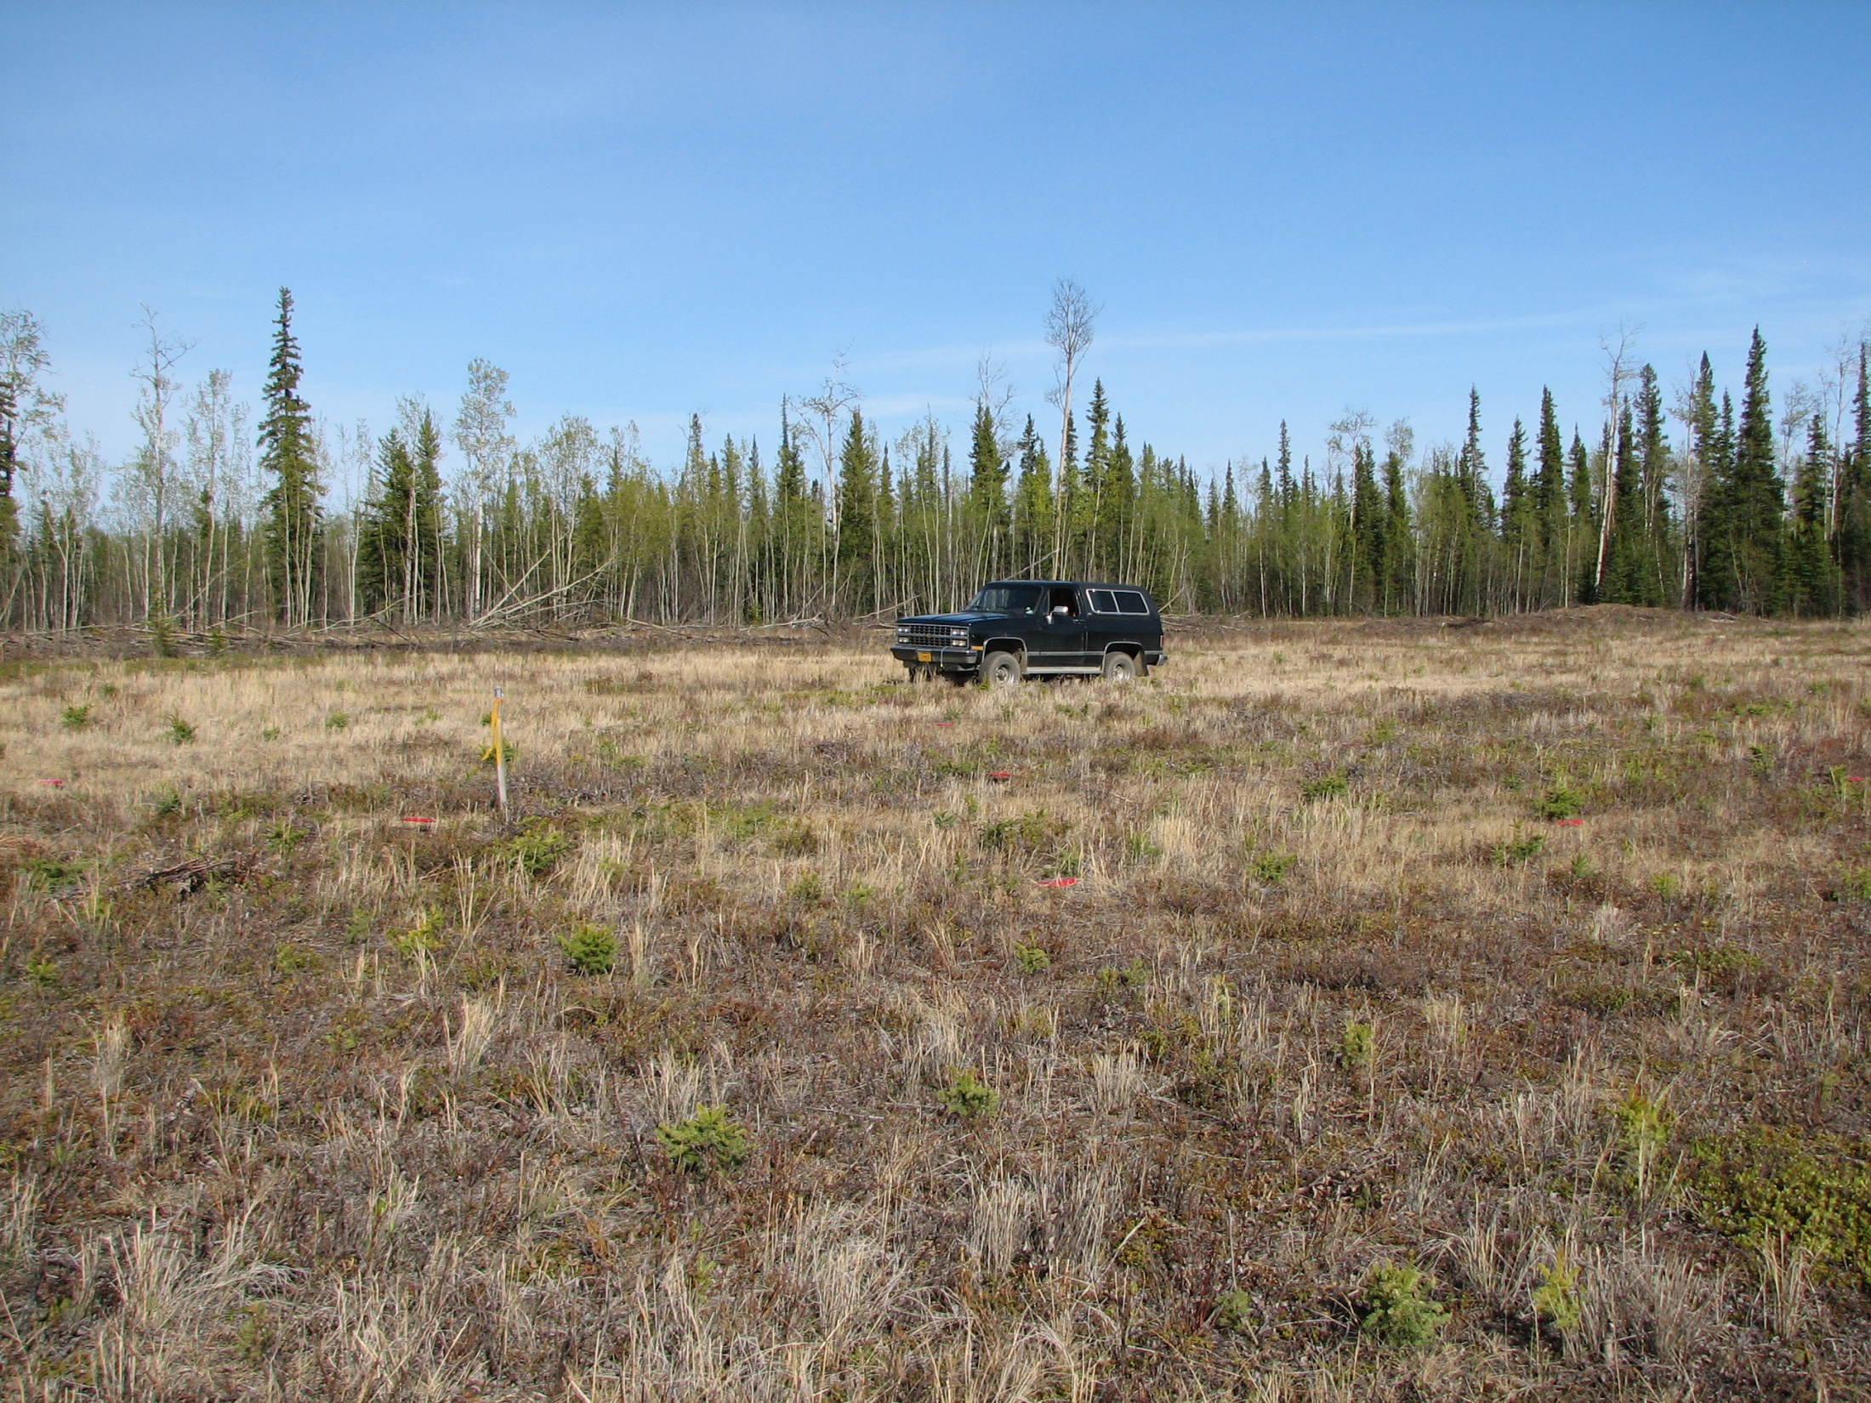
Old CRP Field

Slide 11
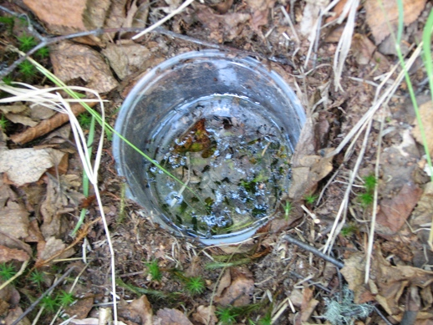
Methods
5 traps were placed at each of 8 plots (40 traps total)
4 traps placed to form a 1m square, with 5th trap in the center
Low toxicity antifreeze (propylene glycol) was used as a preservation fluid -> strained and re-used between sampling periods
Traps were emptied and re-set every 7 days (traps left longer twice)
Sampling was repeated for two summers (2006-2007)
- 140 days in 2006, 141 days in 2007
Total sampling effort: 11,240 trap days ( 281 days x 40 traps)

Slide 12
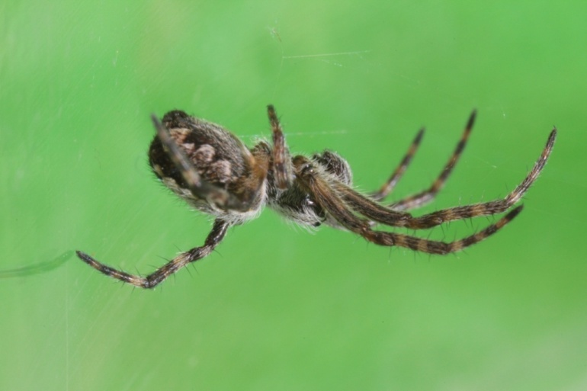
Methods
Immature Dictynid
Samples were sorted to remove by-catch (retained in USDA collection) and adult spiders were identified to species if possible
Immature spiders were identified to family (excluded from statistical analysis)
A few specimens were identified or confirmed by Donald Buckle (Saskatoon, Saskatchewan) or
Jozef Slowik (UA Museum)
Notes:
A few difficult specimens were also identified or confirmed by Jozef Slowik or Donald Buckle.

Slide 13
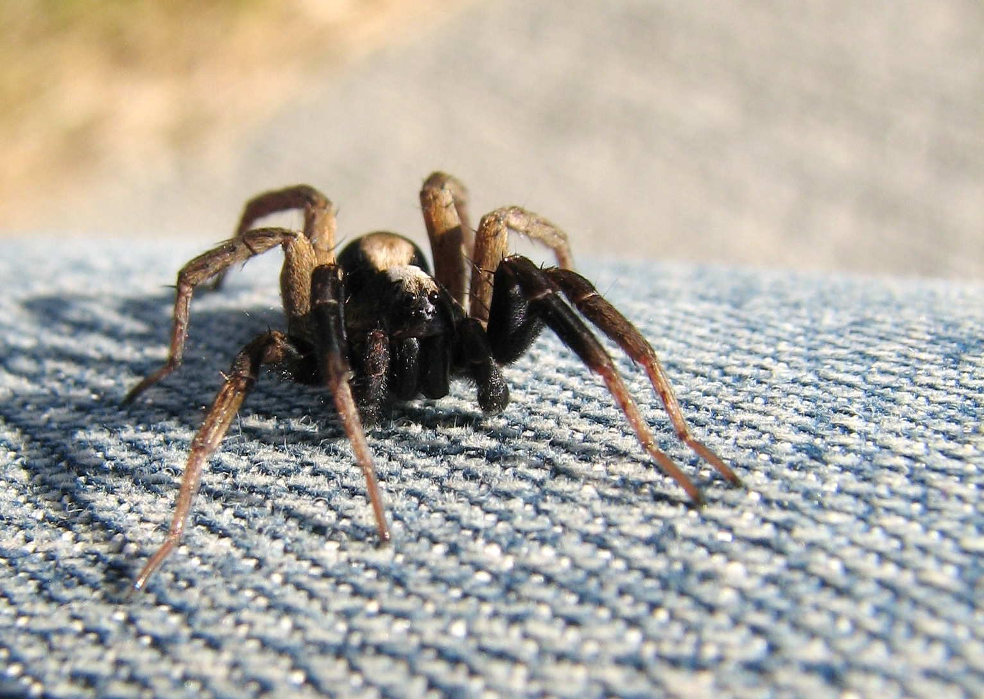
Statistical Analysis
Diversity and species richness - EstimateS 7.5
Sample based rarefaction curves
Shannon’s diversity (H’)
Simpson’s diversity (1/D)
Species richness estimators
(Chao1, Chao2, ACE, ICE,
Jack1, Jack2, Bootstrap).
Alopecosa aculeata (Clerck)
Notes:
Species richness estimates, diversity indices and rarefaction curves were calculated using the program EstimateS

Slide 14
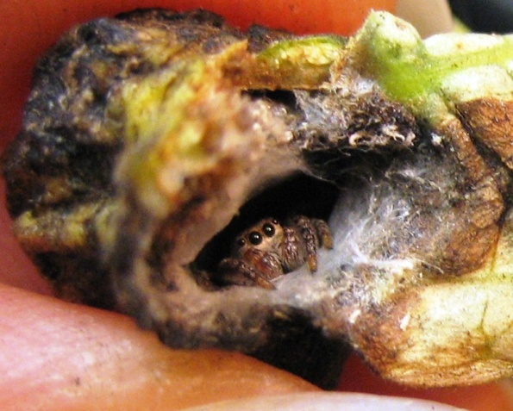
Statistical Analysis
Immature Salticid
Statistical analysis in R 2.11.1:
Pearson’s Chi-Square Test
Non-metric multi-dimensional scaling (NMDS), Bray-Curtis dissimilarity, transformed/standardized, 2 dimensions, PC rotation, rare species excluded (≤3% dominance)
Non-parametric permutation MANOVA (Adonis in R), 4999 permutations
Mantel’s Test – Spearman’s rank correlation,
4999 permutations
Notes:
Chi-Square test – was used to compare the observed distribution of spider families between old and young sites, to see if they differed from the expected distribution of equal abundances between old and young
NMDS –Method used to visualize differences in species composition between sampling plots. NMDS uses ordination to display differences based on a ranked dissimilarity matrix – Bray Curtis dissimilarity (not biased by zeros), log+1 transformation and double-wisconsin standardization, repeated random starting configurations to find stable 2 dimensional ordination, In order to reduce effect of rare species, we only included those that occurred in >3% abundance at any site.
NPMANOVA or PerMANOVA – Test for differences in species composition between old and young CRP sites. Basically a non-parametric equavalent of ANOVA. With this test we take the dissimilarity matrix used in the NMDS, and compare the sums of squared of differences between and within groups (age groups). This is a permutation test, so it calculates a p-value based randomly re-shuffling the data many times and comparing to a pseudo-F distribution.
Wanted to see if we could relate differences seen by age to environmental characteristics
Mantel’s Test – Test for relationship between species composition and environmental characteristics. Takes bray-curtis dissimilarity matrix for spider species used in the NMDS and a euclidean dissimilarity matrix based on vegetation data and tests for a correlation.
I haven’t yet figured out the best method to test for relationship with individual vegetation characteristics, but I did examine correlations with the NMDS axes, which doesn’t provide a direct test, but can at least suggest which vegetations characters are likely to be most important.

Slide 15
Results
10,307 specimens were collected, 3,329 in 2006, and 6,978 in 2007
7,420 adults (68.8%), 2,887 immatures (31.2%)
3,271 specimens collected in old fields, and 4,149 in young fields
15 families, 63 genera, 102 species
25 new state records (24.5%), 1 record new
to Nearctic (Platnick 2011) 2 potentially
undescribed species, 1 species undescribed
females
Arctobious agelenoides (Emerton)
Notes:
Over 800 more specimens collected in young than old fields
Hypsosinga albovittata (Westring) is new to the Nearctic, known from Europe, North Africa, Russia, and Ukraine (Platnick 2010)

Slide 16
Results
The family Lycosidae was the most abundant in all plots and accounted for 50.1% of all individuals collected (adults and immature).
Other families between 0.01%-16%
Two species most abundant, common
to all sampling plots: Pardosa moesta
(15.2%) and P. concinna (10.7%).
Pardosa concinna (Thorell)

Slide 17
Seasonal Abundance
Figure 1 – Seasonal abundance of spiders in CRP fields in 2006 (left) and 2007 (right).
2006
2007
Notes:
Sampling was started much later in 2006 than in 2007 – June 6 vs. 18 May.
Spiders appear to be active early in the spring, before ground is fully thawed.
Spiders peak in early summer (mid June) – In 2006 abundance negligible after the end of August, and in 2007 they disappeared a little earlier, around early August. So not affected by late season mowing, which usually occurs around mid to late August.
Note: in the fall of both years there was an occasion when trap samples were not collected, and thus represent >7 days sampling, resulting in a small peak in the graph, especially noticeable in 2007 (right)
2007 much higher abundance than 2006, even if you only compare samples from the same collection dates. The highest catch per sampling date was aboug 950 in 2007 as compared to 550 in 2006.

Slide 18
Diversity - Species Richness and Evenness
Table 1 – Species Richness of Spiders in Old (19 yrs) and Young (8-10 yrs) CRP grasslands.
 | Old Fields | Young Fields
Total # Species Collected | 76 | 82
Mean # Species Collected | 46 ±2 | 46 ±5
Calc. Species Richness (MaoTau) | 73 ±6 | 73 ±4
Total # Unique Species | 21 | 24
Chao1 Estimated “True” Richness | 76 ±7 | 82 ±8
Table 2 – Diversity and Evenness of Spiders in Old (19 yrs) and Young (8-10 yrs) CRP grasslands.
 | Old Fields | Young Fields
Shannon's Diversity H' | 3.02 ±0.03 | 2.59 ±0.05
Simpsons Diversity 1/D | 14.1 ±0.56 | 6.51 ±0.41
Species Evenness J | 0.69 | 0.59
Notes:
Because there wasn’t a clear difference in the calculated species richness, I decided to take a weight-of-evidence approach and compare different measures of species richness. Mean and calculated species richness equal for old and young, however, more specimens were collected in young than in old sites ( ), so if you scale the number of species by catch size, then it really is slightly higher in young fields.
Species richness estimators: from 73-81 for old, from 77-87 for young, but all of them were consistent in estimating more species in young than old. Chao 1 and 2 came up with the same numbers, 76 for old and 82 for young, and were about midway between the other estimators.
Old – Bootstrap 73, ACE 75, ICE 75, Chao1 76, Chao2 76, Jack1 78, Jack2 81,
Young – Bootstrap 77, ACE 81, ICE 81, Chao1 82, Chao2 82, Jack1 83, Jack2 87
Actual number of species collected: 78 in OLD and 82 in Young. These numbers seem to suggest that we sampled thoroughly enough at least to have a fair representation of the spider community in these fields.

Slide 19
Species Richness
Figure 2 – Species rarefaction curves and Chao 1 estimated ‘true’ richness for old and young CRP fields
Notes:
Species rarefaction curves, sample based, but scaled to number of individuals to show difference, show the accumulation of species across sampling time. Keep in mind that the species richness is calculated based on resampling with replacement from the pooled data, so it is not the same as the actual number of species collected. Both old and young come up with the same number of species = 73. However, for the same number of individuals collected, old has a slightly higher richness (73 vs. 69).
Not sure why the estimated species richness would be higher for young than old, it may be that young sites actually do have higher richness, but that’s not what we would expect to see.

Slide 20
Rank Abundance
Figure 3 – Species rank abundance for spiders in old (left) and young (right) CRP grasslands, 2006-2007.
Young Fields
Notes:
Young CRP Fields appear less even, with a steeper species curve- 28 singletons compared to old fields
Old CRP Fields - 17 singletons
Switch in dominance between the two most abundant species overall, both of which were lycosids. Pardosa moesta was dominant in young with 1377 specimens, followed by P. concinna with about 688. In old fields P. concinna dominant with over 416 specimens, followed by A. utahana as the next most abundant, and P. moesta in 7th with only 187 specimens.

Slide 21
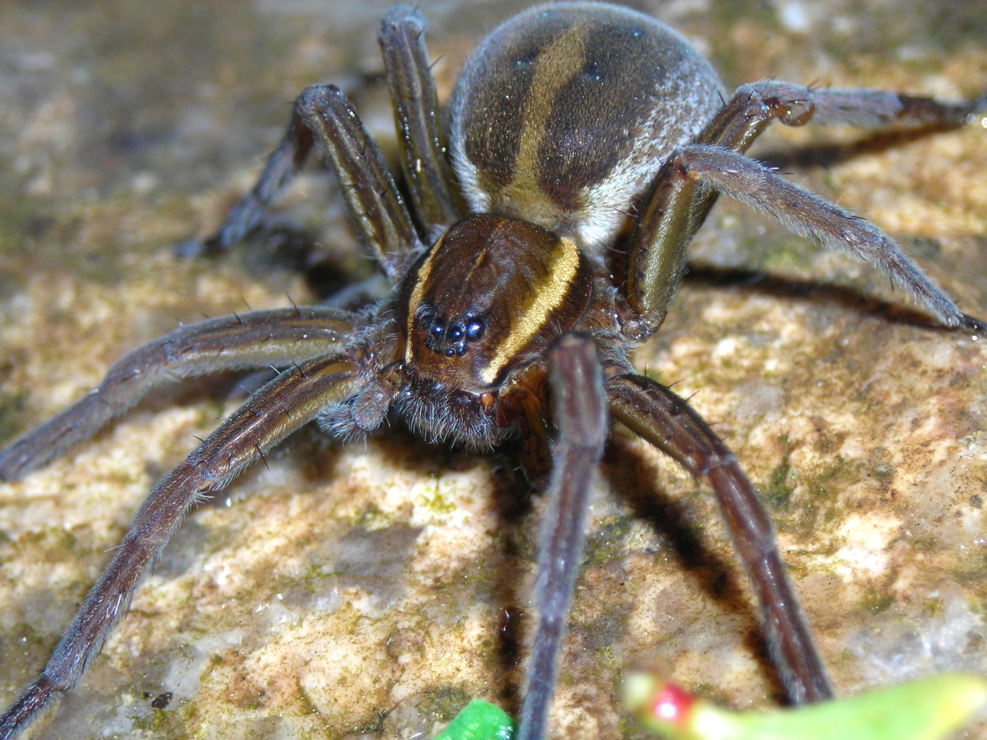
Results – Families
Table 3 – Mean percentages of the 5 most abundant families in Old and Young CRP grasslands, 2006-07.
Lycosidae Gnaphosidae Linyphiidae Thomisidae Agelenidae
Old Fields (19 yrs) 37.2% 14.1% 15.4% 17.7% 9.7%
Young Fields (8-10 yrs) 62.5% 11.4% 12.0% 9.7% 0.9%
Distributions differed significantly (p<0.05) between old and young fields in both 2006 and 2007, X² = 353.5 and 303.7 respectively, critical value= 11.07 (a=0.05, df=5).
Dolomedes triton (Walckenaer)
Notes:
Change in proprortions - Between young and old CRP fields, the percentage of Lycosids decreased by 25%, Agelenids increased by 8.8%, and Thomisids increased by 8.0%. Linyphiids and Gnaphosids showed only very slight increases of 3.4% and 2.7% respectively, with standard deviations greater than the differences between young and old.
In terms of guilds – Lycsoids and Gnaphosids are cursorial hunting spiders, Agelenids are vagrant sheet-web builders, and Linyphiids are vagrant tangle web weavers, and Thomisids are sit-and-wait predators.

Slide 22
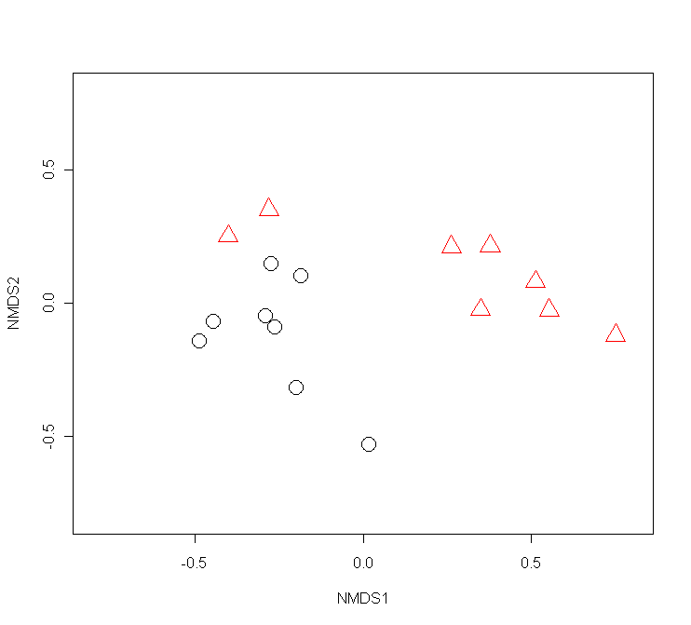
NMDS Ordination Figure 4
Stress = 11.064

Slide 23
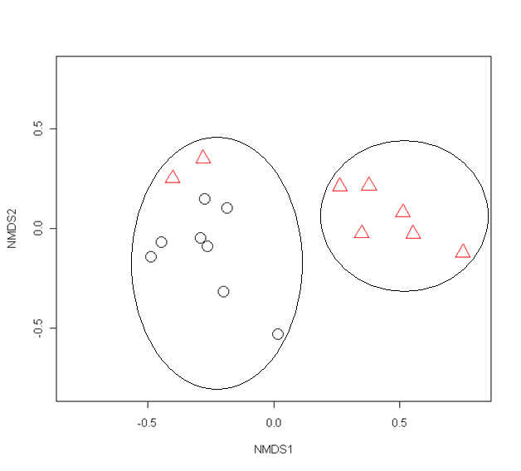
NMDS Ordination Figure 4
Stress = 11.064%
‘badness-of-fit’ Clarke 1993
Notes:
Young Plot 37 more similar to old sites than other young sites.
Kruskal’s stress for the ordination was 11.064%, measure of “badness of fit”, Clarke 1993 – suggest that <10% is ideal, less than 20% is OK, and greater than 20% is not reliable

Slide 24
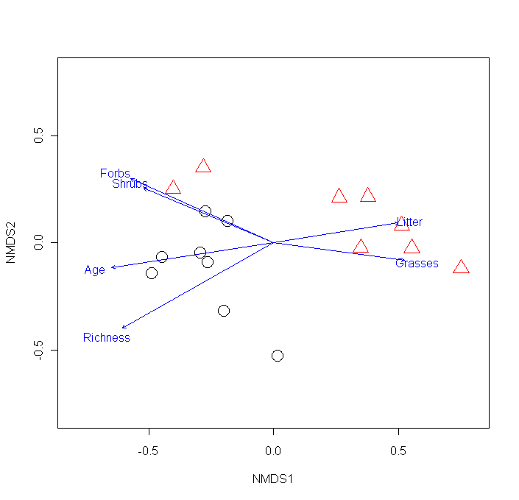
NMDS Ordination Figure 4
Table 4 – Spearman’s correlation coefficients for Plot characteristics vs. NDMS axes
 | Axis 1 | Axis 2
Age | -0.65 | -0.27
Richness | -0.68 | -0.32
Litter | 0.62 | 0.18
Forbs | -0.69 | 0.22
Grasses | 0.45 | -0.05
Shrubs | -0.57 | 0.17
Stress = 11.064
Notes:
The blue arrows show relationships between vegetation variables and the NMDS axis (based on spider species composition dissimilarity between collection sites). Appear to be separating more along differences in vegetation than by Age.
Along axis 1 (from left to right) Age, plant species richness and % cover of forbs and shrubs decrease, and % cover of litter and grass increase. Along axis 2 (from bottom to top) Age, richness and grasses decrease, and forbs, shrubs and litter increase. % Forbs has strongest correlation with axis 1, although it’s closely followed by age, then litter and shrubs. Also, if you run a correlations between the variables, they’re al highly correlated with each other.
Richness most important to axis two, although not a strong relationship with any of the variables.
The Young fields had higher % cover of litter than the old fields, which is rather counter-intuitive (but its NOT depth, it’s cover),Since the younger field are still primarily grass covered, and are mowed every few years without baling or grazing to pick up the cut grass, they have thick mats of dead grass cover. In older fields, the dead grass has probably de-composed more and thus does not compose an obvious mat-cover on the ground.
Plot 37 was higher in forbs

Slide 25
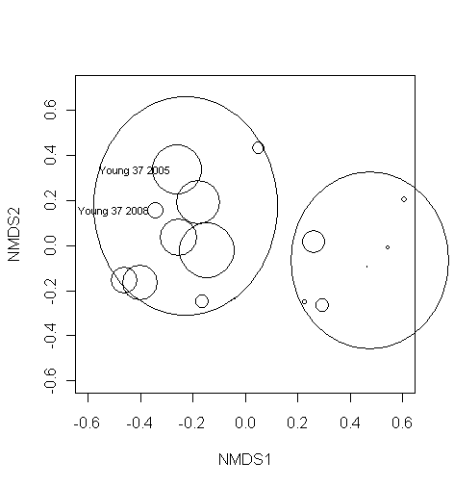
% Cover Forbs Figure 5
Notes:
Young 37 outlier in Seefledt et al. 2010 study – 37 higher in total herbacious and total perennial cover than average for Young fields,
Young Site 37 was on average higher in Forbs and Shrubs, and lower in litter than other young fields.

Slide 26
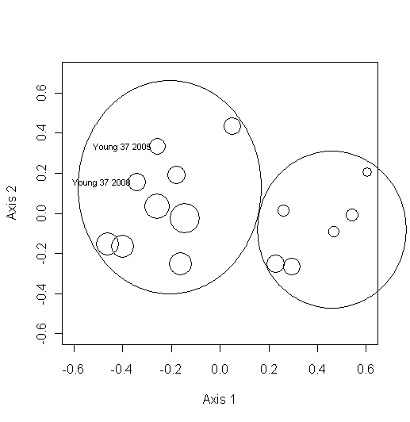
Plant Species Richness Figure 6
Notes:
Young 37 and Old 27 outliers in Seefledt et al. 2010 study – 37 higher in total herbacious and total perennial cover than average for Young fields, 27 twice as much cover of Populus seedlings than than other old feelds. 27 is odd, in that the two years are far apart on axis 2 – probably due to difference in plant species richness at that sight between 2005 and 2008 (33 vs. 25).
Young Site 37 was on average higher in Forbs and Shrubs, and lower in litter than other young fields. In 2005 it was

Slide 27
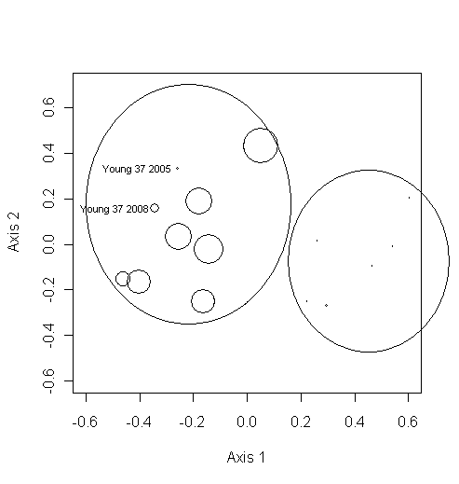
% Cover Shrubs Figure 7
Notes:
Young 37 and Old 27 outliers in Seefledt et al. 2010 study – 37 higher in total herbacious and total perennial cover than average for Young fields, 27 twice as much cover of Populus seedlings than than other old feelds. 27 is odd, in that the two years are far apart on axis 2 – probably due to difference in plant species richness at that sight between 2005 and 2008 (33 vs. 25).
Young Site 37 was on average higher in Forbs and Shrubs, and lower in litter than other young fields. In 2005 it was

Slide 28
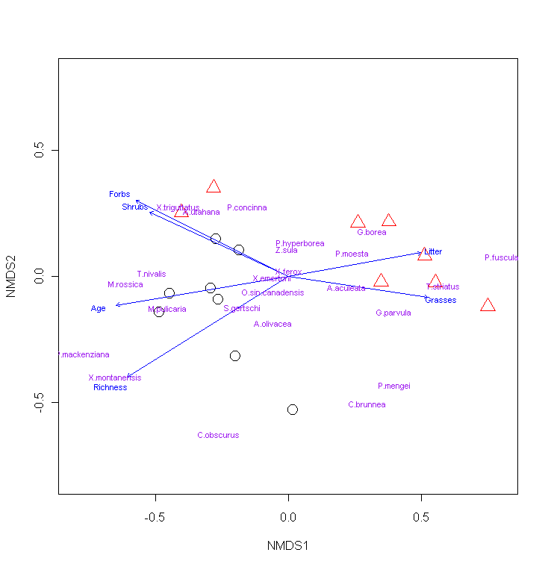
NMDS Ordination Figure 4
Stress = 11.064
Notes:
Even though Lycosids overall were more abundant in young sites, few Lycosid species individually were very important to separation of the NMDS clusters (one-P.fuscula)/ Pardosa moesta and concinna, the two most abundance species, were among those that are relatively un-important to separation of the NMDS clusters because they were present in all sites, even though P. moesta was quite a bit more abundant in young sites.

Slide 29
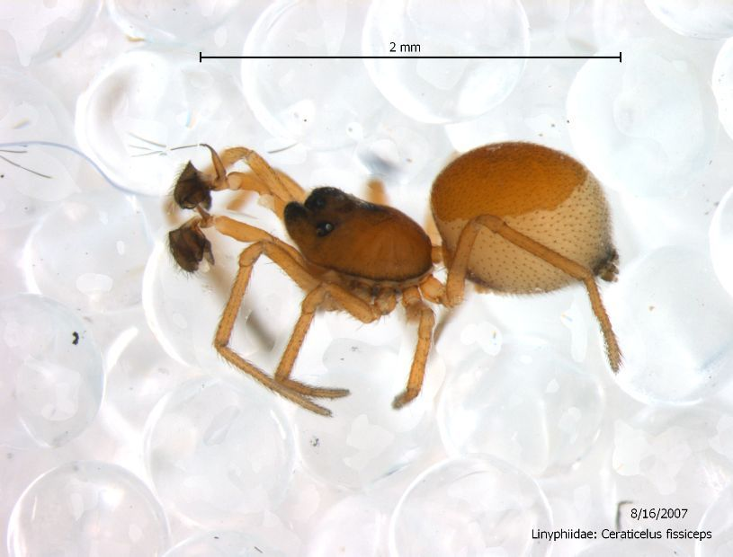
Species Importance
Table 5 - Total Abundance of species most important to NMDS axis 1 (| >0.5| weighted average) in old (19 yrs) and young (8-10 yrs) CRP fields.
Species | Old | Young
Micaria rossica | 37 | 2
Xysticus montanensis | 29 | 2
Pardosa mackenziana | 14 | 0
Titanoeca nivalis | 75 | 10
Pardosa fuscula | 0 | 109
Thanatus striatus | 7 | 84
Ceraticelus fissiceps (O. P-Cambridge)
Notes:
Weighted average = how much they contributed to the dissimilarity coefficient for each pair of sites.

Slide 30
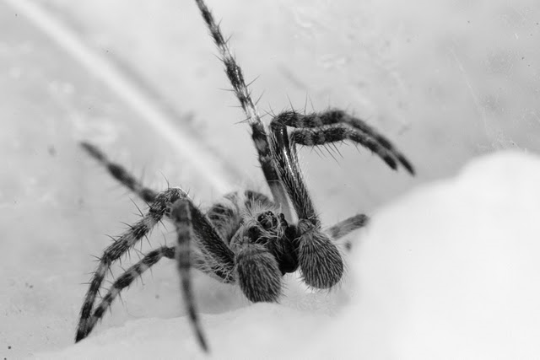
Species Importance
Table 6 - Total Abundance of species least important to NMDS (|<0.06| weighted average for either axis) in old (19 yrs) and young (8-10 yrs) CRP fields.
Species | Old | Young
Xysticus ferox | 204 | 236
Zelotes sula | 293 | 257
Pardosa hyperborea | 319 | 40
Xysticus emertoni | 140 | 69
Ozyptila sincera canadensis | 95 | 25
Agyneta olivacea | 79 | 132
Immature Dictynid
Notes:
The species that I would expect to be most important based on change in abundance between young and old fields were not necessarily the same as those most important to the separation of sites, because this takes into account their presence or absence in all collecting sites, not just pooled between young and old.

Slide 31
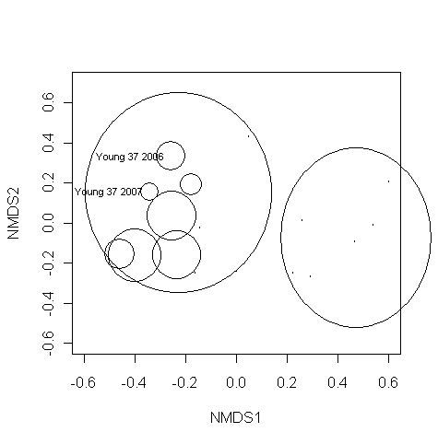
Species abundance – M. rossica Figure 8
Notes:
Not found at all in young sites except the outlier site 37, which may suggest that their distribution is more influenced by vegetation characteristics than field age alone.

Slide 32
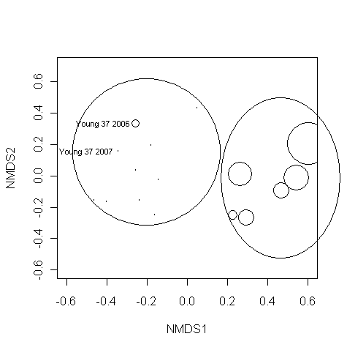
Species abundance – P. fuscula Figure 9
Notes:
A Lycosid, not found at all in old sites, and only found in very low abundance one year in the outlier site young 37.

Slide 33
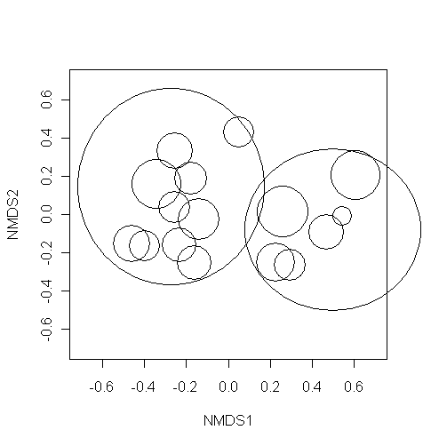
Species abundance – X. ferox Figure 10

Slide 34
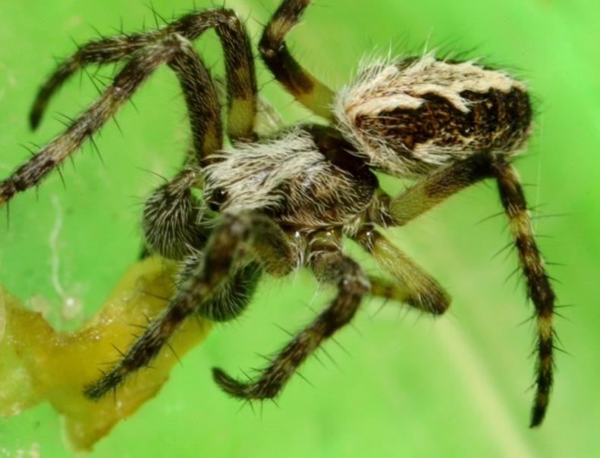
PerMANOVA and Mantel’s Test
Table 7 –Non-parametric permutation MANOVA (Adonis) on Bray Curtis distances
for spider abundances in young (8-10 yrs) and old (19 yrs) CRP fields.
Df SumsOfSqs MeanSqs F.Model R2 Pr(>F)
Age 1 0.31778 0.31778 5.7529 0.29124 0.0018 **
Residuals 14 0.77334 0.05524 0.70876
Total 15 1.09112 1.00000
Mantel’s Test for overall correlation between species composition and vegetation data was
significant (P <0.001).
Immature Dictynid
Notes:
Mantel’s test shows that vegetation characteristics are influencing species composition

Slide 35
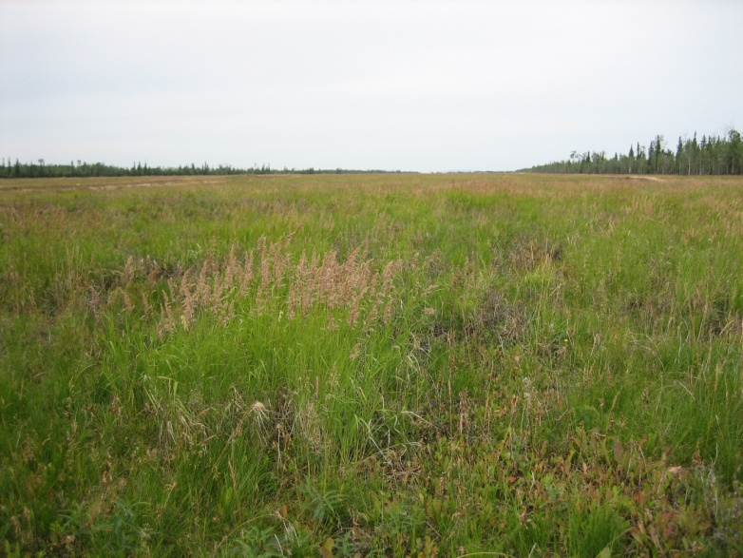
Discussion
Species diversity -> No strong evidence for hypothesis of higher diversity in older fields with greater vegetation complexity
Diversity (Shannon’s H’ and Simpson’s 1/D) was only slightly higher in old fields
Evenness was higher in old fields
Species richness (S) was slightly lower in old fields (although conflicting between total S, mean S and maotau S)
CRP field Delta, AK
Notes:
Perhaps more time is required to see a marked increase the spider species richness as compared to the increase than it does for the plant species richness, and other vegetation characteristics.
Discuss findings of other studies

Slide 36
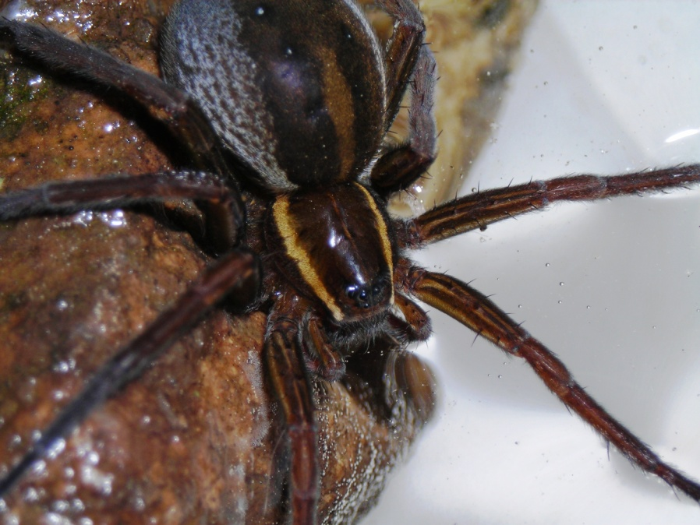
Discussion
Spider species composition -> Differed significantly between Old and Young fields
By family -> X² test of distributions, observed percentages
By species -> NMDS ordination, PerMANOVA test
45 unique species (21 old, 24 young), more shared species within (60% old, 63% young) than between age groups (54%)
The differences observed in species composition between all CRP sampling plots were significantly correlated with differences in vegetation characteristics
Mantel’s Test
Dolomedes triton (Walckenaer)
Notes:
There were shifts in the abundance of some of the dominant families in CRP fields. The differences observed at the family level were also seen in other studies. Hurd and Fagan 1992, and Koponen 2005 also saw trends for a decrease in the abundance of Lycosids over successional time, and Bultman et al. 1982 saw a decrease in Lycosids, as well as an increase in vagrant web-builders (Hahniidae, the same guild as the Agelenidae) and for the sit-and-wait predators, Thomisidae.
With the exception of one outlier field, those fields from the same age group were more similar to each other than to those of the opposing age.
There were 21 unique species in old plots, and 23 in young plots. If you compare the number of shared species, there was considerable variation within age groups, however there were still more shared species within (62%) than between age groups (56%). By within I mean occurred in 2 or more plots, and by between I mean occurred in at least one old and one young plot. Only ~ 14% of species were found in all sites.
Correlated with vegetatin characteristics -> didn’t test which ones specifically, but forbs had the had the highest correlation with the NMDS axes, followed by plant species richness, and shrubs.

Slide 37
Conclusions
Micaria pulicaria (Sundevall)
This research provides evidence in support of the hypothesis of successional spider communities
The relationship between successional age, vegetation complexity and ground spider diversity is still unclear
This study contributes substantially to the documentation of the spider fauna of Alaska
Notes:
This research provides evidence in support of the hypothesis of successional spider communities for some species that are habitat specialists, preferring older or younger sites, in effect choosing sites with more or less vegetation structure and complexity, depending on their habitat requirements. At the family level, this research corroborates the findings of some previous studies that suggest a trend of decreasing cursorial wandering spiders (Lycosidae), and increasing vagrant web builders (Agelenidae) and litter-dwelling sit-and-wait predators (Thomisidae).
The relationship between successional age, vegetative complexity of habitats and ground spider species diversity is still unclear. This question would benefit from studies that look at a broader range of habitats across succession gradients and time (high inter-annual variability), as well as experimental studies that separate the effects of various factors to determine which specific habitat characteristics influence spider diversity.
This study contributes substantially to the documentation of spiders in interior Alaska by producing species records from a virtually un-collected area, and adding at least 25 species to the checklist of AK spiders.

Slide 38
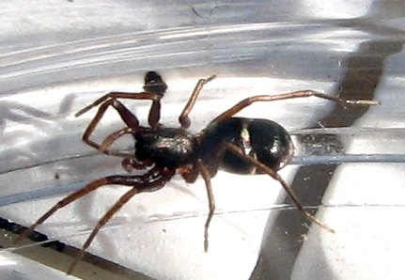
Acknowledgements
Vegetation Data: Steve Seefeldt
Identifications: Donald Buckle, Jozef Slowik
Technical Assistance: Aaron Haggerty, Bethany Sweet, Candace Flint, Cary Curlee, Jonathan Nigg, Megan Richards, Richard Ranft, Susan Emmert
CRP Land Owners: Harold and Orrie Olson, Karen Olson, Mike and Scott Shultz
Micaria pulicaria (Sundevall)

Slide 39
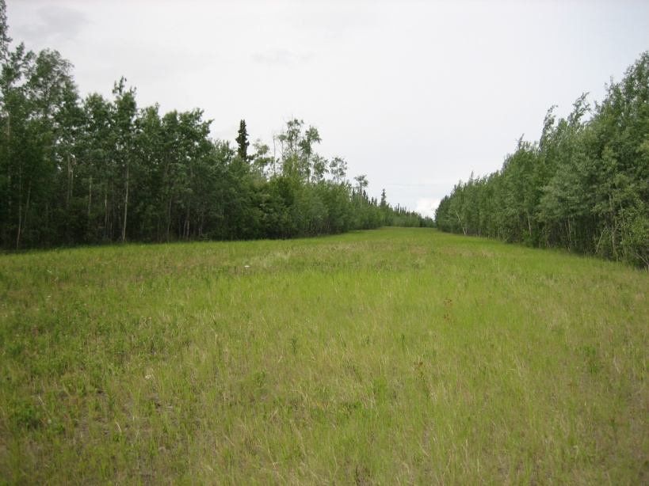
Literature Cited
CRP field Delta, AK
Butlman, T.L., G.W. Uetz and A.R. Brady. 1982. A comparison of cursorial spider communities along a successional gradient. The Journal of Arachnology10:23-33.
Clarke, K.R. 1993. Non-parametric multivariate analyses of changes in community structure. Australian Journal of Ecology 18:117-143.
Hurd, L.E. and W.F. Fagan. 1992. Cursorial spiders and succession: age or habitat structure? Oecologia 92:215-221.
Mallis, R.E. and L.W. Hurd. 2005. Diversity among ground-dwelling spider assemblages: habitat generalists and specialists. The Journal of Arachnology 33:101-109.
Platnick, N.I. 2011. The World Spider Catalog, V. 11.5. Online [Accessed JAN 2011]: http://research.amnh.org/iz/spiders/catalog
Rushton, S.P. and M.D. Eyre. 1992. Grassland spider habitats in north-east England. Journal of Biogeography 19(1):99-108.
Rypstra, A.L., P.E. Carter, R.A. Balfour and S.D. Marshall. 1999. Architectural features of agricultural habitats and their impact on the spider inhabitants. The Journal of Arachnology 27:371-377.
Seefeldt, S.S., J.S. Conn, M. Zhang and P.N. Kaspari. 2010. Vegetation changes in Conservation Reserve Program lands in interior Alaska. Agriculture, Ecosystems and Environment 135:119-126.
Siemann, E., D. Tilman, J. Haarstad and M. Ritchie. 1998. Experimental tests of the dependence of arthropod diversity on plant diversity. The American Naturalist 152(5):738-750.
Uetz, G.W. 1991. Habitat structure and spider foraging. Pp. 325-348. In Habitat Structure: The Physical Arrangement of Objects in Space. (S.S. Bell, E.D McCoy and H.R. Mushinsky, eds.)., Chapman and Hall, London, U.K.

Slide 40
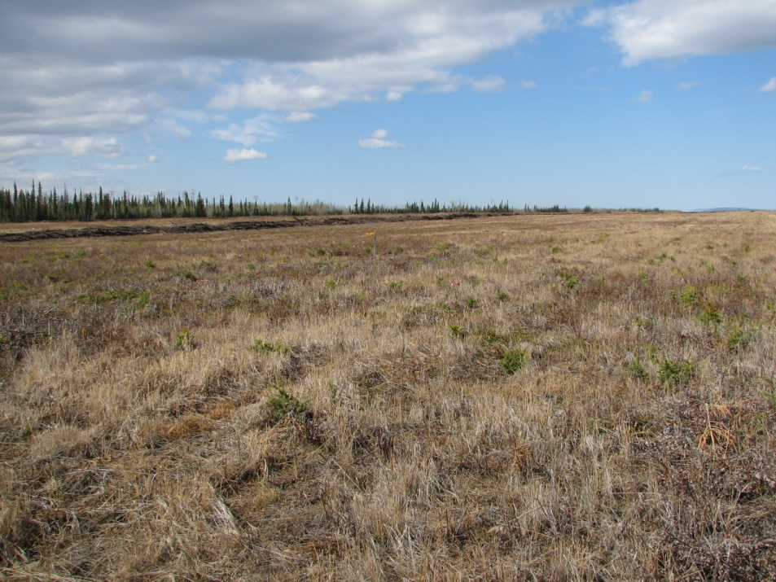
Thank You

