Slide 1
Dominique Collet's contribution to the UAM insect Collection
Sayde Ridling
Senior at UAF
Lab assistant hired by UAM to curate and database the Collet accession.

Slide 2
Dominique Collet
Who is Dominique?
Kenai Peninsula naturalist
talks on mycology, willow plant identification, and of course entomology
He is considered an expert on the Kenai Peninsula gall midges and the tiny parasitoid wasps who attack them.
Author of the field guides to willows and to insects of South Central Alaska.

Slide 4
Summary of the Donation
10,320 specimen lots
11 orders plus and additional 14 un-cataloged
335 identified spp.
84 of which are new records for Alaska
Work to fully integrate Collet’s specimens into the museum collection thanks to a generous NSF grant obtained by Dr. Derek Sikes, curator of the insect collection at the UA museum.
I was the undergrad hired to do the work on Dominique Collet’s collection.
Notes:
I was lucky enough to be the undergraduate hired over the summer to work on Dominque Collet’s colleciton and I have to say it is an experience I truly enjoyed.

Slide 5
Overview of orders in donation
Note that this graph excludes all un-cataloged specimens.

Slide 6
Hemiptera
441 total lot count
289 (to order)
111 (to fam.)
17 (to gen.)
24 (to spp.)
8 identified spp.
1 new record for AK
Not yet fully processed
Notes:
An idea of the extent of identification done.

Slide 7
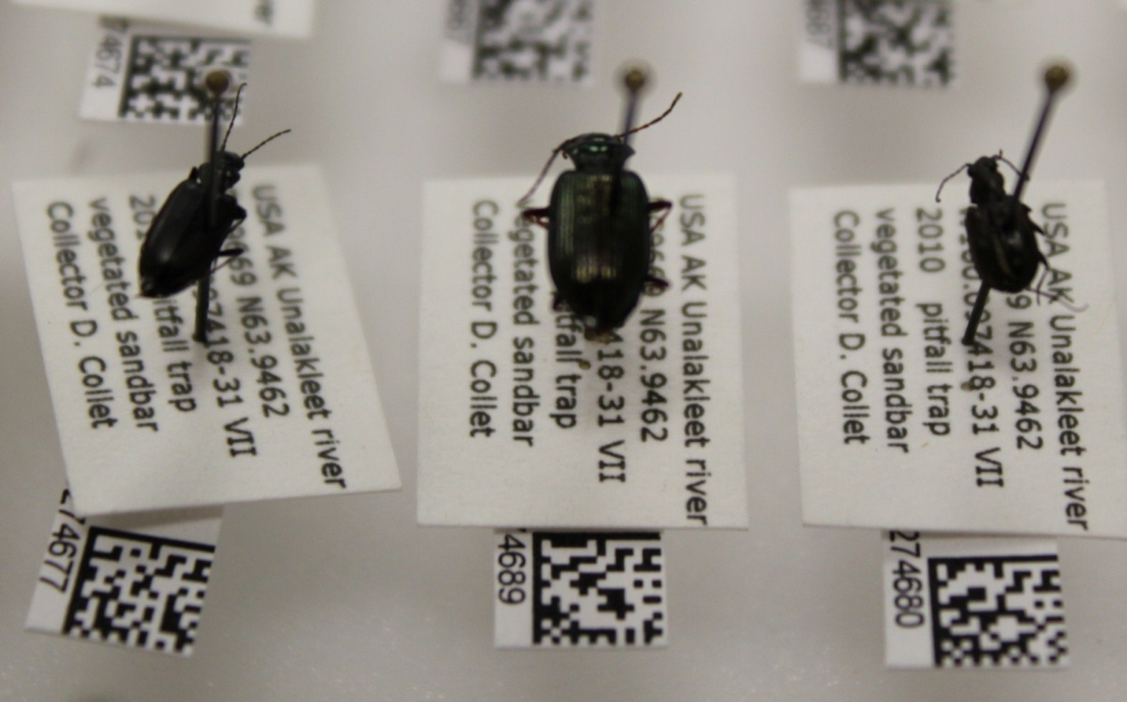
Coleoptera
2565 total lot count
67 (to order)
914 (to fam.)
355 (to gen.)
1229 (to spp.)
84 identified spp.
3 new records for AK

Slide 8
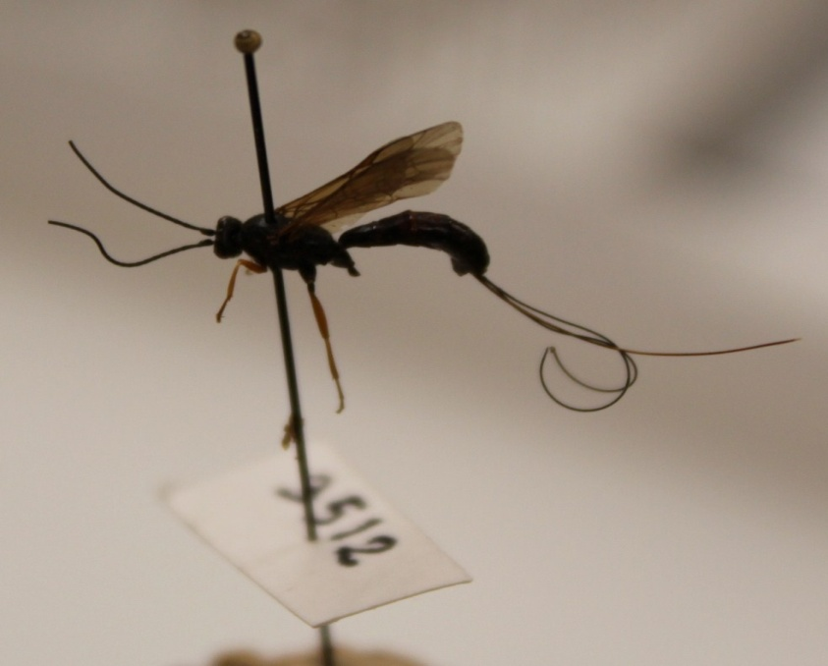
Hymenoptera
3825 total lot count
1830 (to order)
1529 (to fam.)
224 (to gen.)
236 (to spp.)
44 identified spp.
15 new records for AK
Notes:
The order with the most specimens from his donation

Slide 9
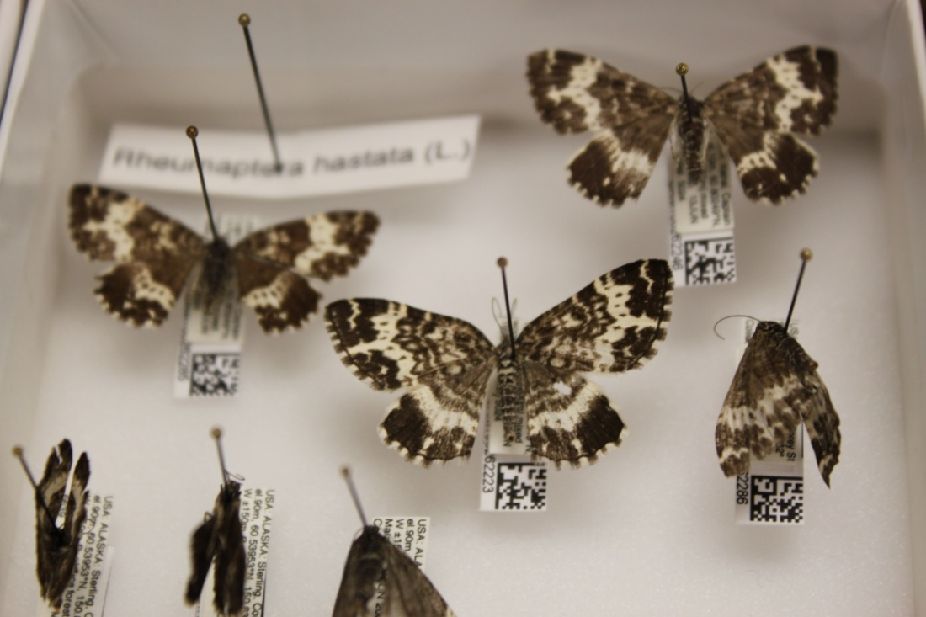
Lepidoptera
1442 total lot count
502 (to order)
17 (to fam.)
84 (to gen.)
839 (to spp.)
99 identified spp.
47 new records for AK.

Slide 10
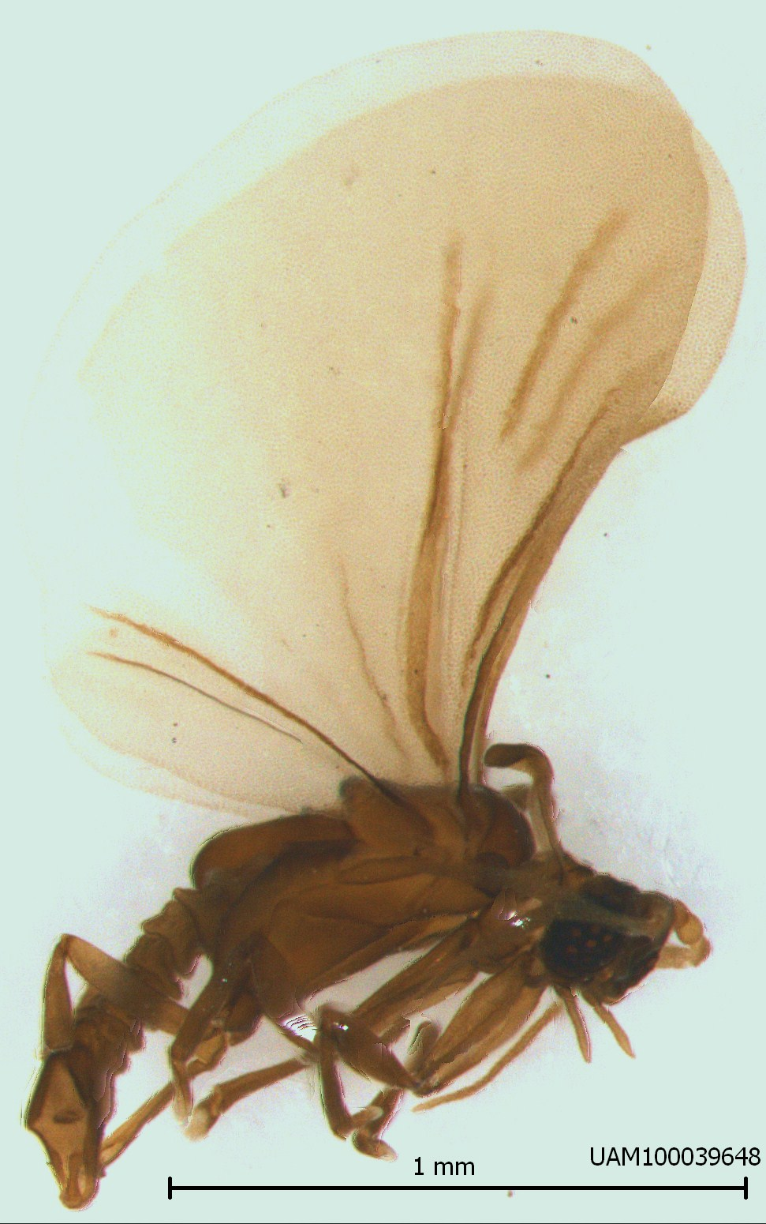
Strepsiptera
1 specimen the first and only known from the State.
ID = Elenchus sp.

Slide 11
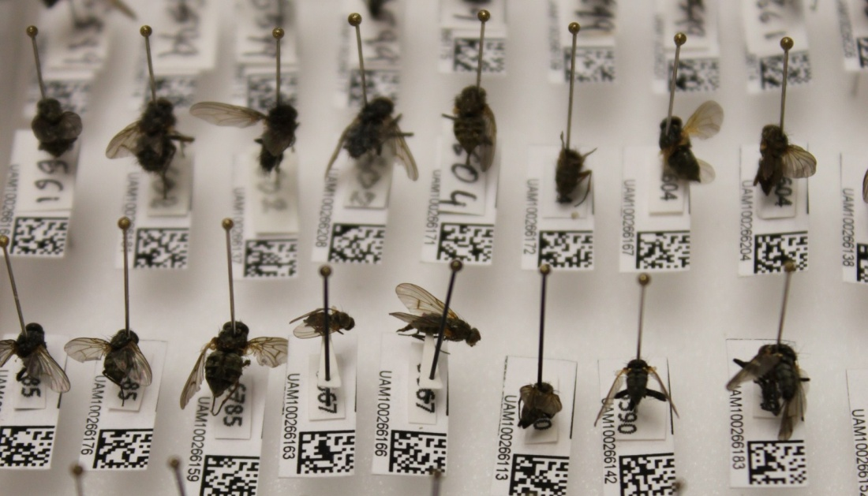
Diptera
2,015 total lot count
1,262 (to order)
485 (to fam.)
80 (to gen.)
87 (to spp.)
13 identified spp.
1 new record for AK

Slide 12
Minor insect orders
Archeognatha 1 (not yet cataloged)
Ephemeroptera 7 (not yet cataloged)
Odonata 8 (not yet cataloged)
Orthoptera 3 (2 to fam. 1 to sp.)
Plecoptera 4 (not yet cataloged)
Thysanoptera 309 (all to sp.)
Pthiraptera 10 (not yet cataloged)
Psocoptera 68 (not yet cataloged)
Neuroptera 63 (not yet cataloged)
Trichoptera 16 (not yet cataloged)
Siphonaptera 7 (not yet cataloged)

Slide 13
Minor non-insect orders
Acari 28 (all to order)
Aranaea 5 (not yet cataloged)
Anostraca 2 (not yet cataloged)
Chilopoda 2 (not yet cataloged)
Collembola 26 (not yet cataloged)
Crustacea 1 (not yet cataloged)
Opilliones 1 (all to sp.)
Pseudoscorpion 1 (all to sp.)

Slide 14
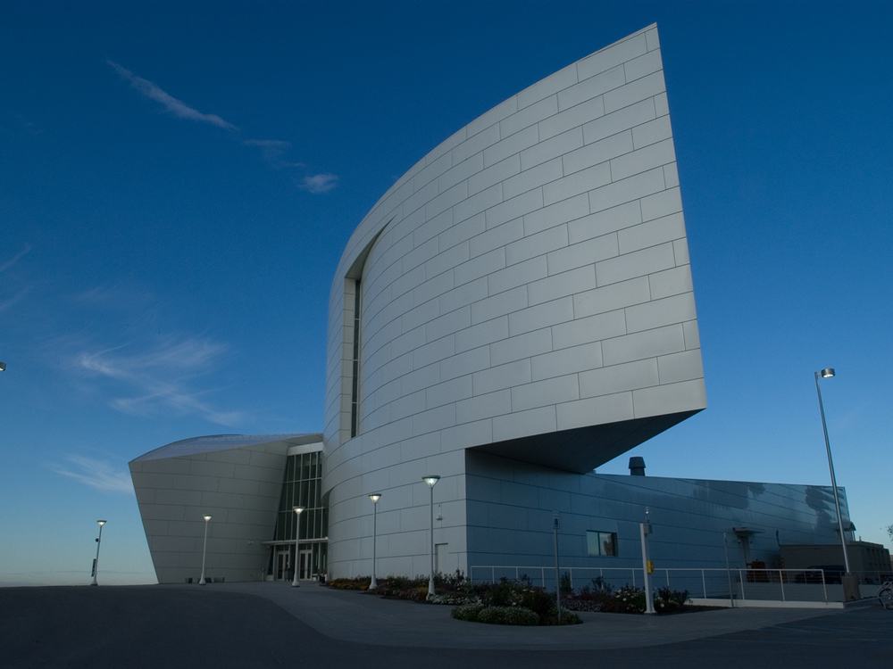
What this means for the UA museum
New species records provide a better record of what insects really do survive in Alaska
Important to entomologists, ecologists, even climatologists
With an estimated over 7,000 species believed to be present in Alaska, we have a long way to go and every sp. counts.
Notes:
This knowledge is of growing importance due to the rapid degree of climate change occurring at high latitude areas. In order to understand the effects of this on the ecological community level biologists as a whole need to understand what species make up the ecological communities before disruption occurs.
These specimens are of particular importance because they provide the museum and any interested biologists with a more complete view of the insect fauna found in our state.

Slide 15
Project specimens species spp. new for AK new sp.
Kanuti NWR (S. of Brooks R.) 11,797 197 31 (16%) 3
AK Peninsula NWR 1,911 79 4 (5%) 1?
USDA ARS 9,930 203 42 (21%) 2
Sanak Island 214 34 3 (9%) 0
AK Maritime NWR 8,389 89 7 (8%) 5+
Sikes property, Fairbanks 2,541 69 11 (16%) 0
Dalton Hwy transect 1,900 38 9 (24%) 1
Aspen Leaf Miner / ants 111 9 4 (44%) 3
Spiders of AK 9,790 423 98 (23%) 2
Prince of Wales 13,986 115 33 (29%) 1?
Koyukuk NWR 550 52 6 (12%) 0
Palmer Collection 6,578
D. Sikes, Alaska 19,388
D. Collet Kenai 10,320 335 84 (25%) 0
Dominique Collet’s donation is the largest individual donation given to the UA museum insect collection aside from the donations made by Dr. Derek Sikes Curator for the insect collection. Dr. Sikes has donated 19,388 specimens to date.
It is also important to note the areas in which specimens were collected

Slide 16
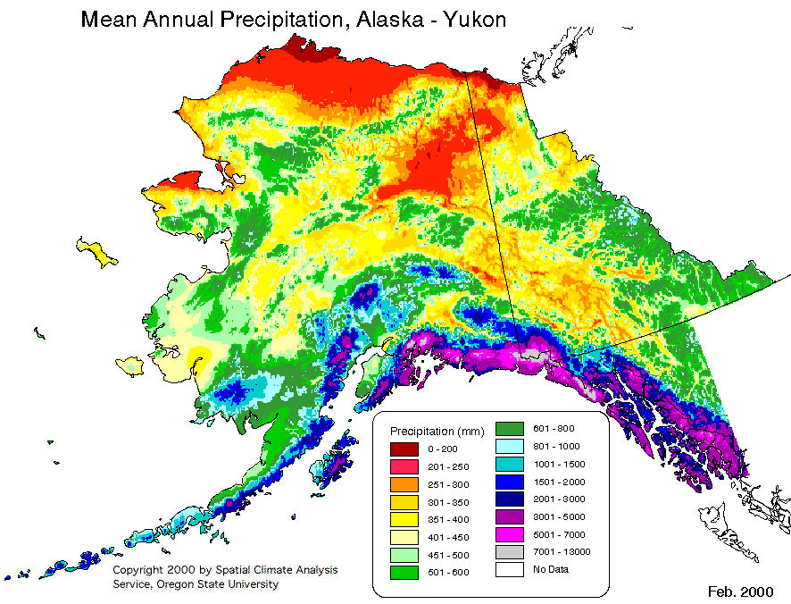

Slide 17
Localities
Dominique Collet’s donation has specimens collected from 1990 – 2010 from 294 different locations most in the Kenai Peninsula area.
His top 5 localities are:
Corey street (6,036)
Sterling Gann site (438)
KNWR Skyline trail (175)
Soldotna Creek park (164)
KNWR Finger lake site 1 (129)

Slide 18
ARCTOS
Arctos
Specimen Catalog label data (and more)
Allows us to publicly post information online
Specimens (objects) - body parts, tissues, containers, etc.
Images, media (stored at TACC)
Accessions, loans, usage
Loans,
usage
Accessions
Projects
contribute and/or
use specimens
Publications
cite specimens
GenBank
GBIF
BerkeleyMapper
Notes:
which allows us to publicly post information about our specimens to organizations such as the Global Biodiversity information facility (GBIF). Therefore by donating his collection Dominique Collet has not only given its benefits to the UA Museum but to the scientific community as a whole.

Slide 19
Thank You
He has contributed countless hours of his time, effort, and knowledge both to the museum and any entomologist who has thought of studying Alaskan insects, including myself.
It is for that time, dedication, and generosity that I would like to express sincere thanks to Dominique from both myself and the UA museum.

Slide 20
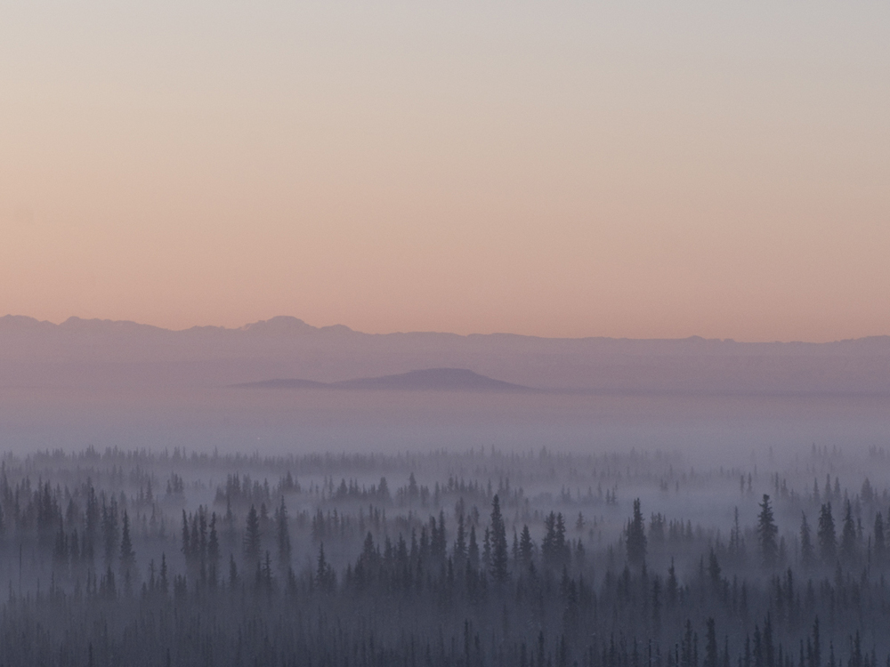
Acknowledgments
Dr. Derek Sikes
- University of Alaska Museum
National Science Foundation
Entomology Society of Alaska
-Thanks for letting me talk!

